Slide 1
CAPSTONE PROJECT
Data Analysis Using Tableau

Slide 2
PROJECT OBJECTIVE
Analyze the customer data of a North American bank and build an interactive dashboard using Tableau. Building a dashboard will involve analyzing the data and presenting the results using appropriate charts/graphs.

Slide 3
CUSTOMER CHURN ANALYSIS
A certain bank in North America wants to perform customer churn analysis, as the credit card business of the bank is not performing very well. Churn analysis will help the bank evaluate the customers who have stopped purchasing the credit card of the bank and figure out measures to reduce the bank’s customer loss rate.
Ella, a data analyst, has been asked to analyze the bank’s customers’ churn data by performing the tasks given in upcoming slides.

Slide 4
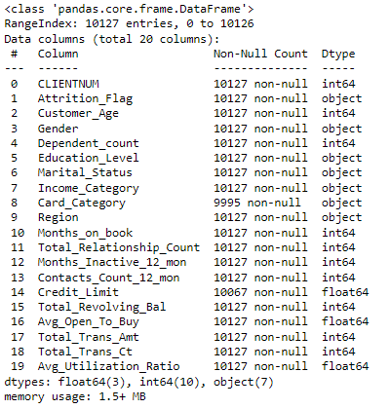
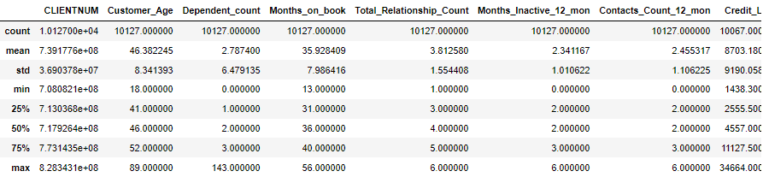
Perform the below steps on the data before loading it into Tableau Public:
Display the summary statistics of the dataset.
Identify the outliers in the dataset. (if there any)
Identify the missing values in the dataset and display the count of missing values.
Perform Data Imputation, using whichever method suits most logically for the given columns in the dataset.
DATA PRE PROCESSING USING PYTHON

Slide 5
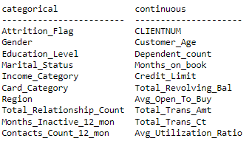
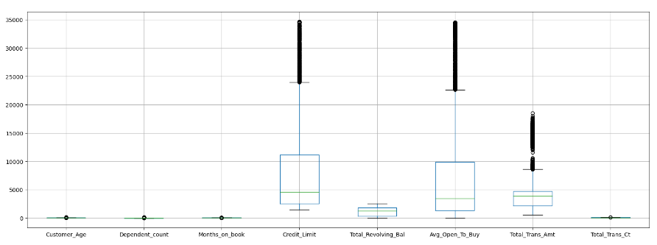
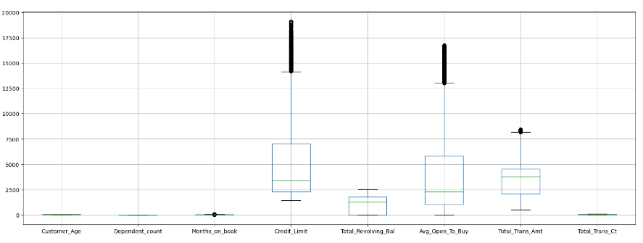
DATA PRE PROCESSING USING PYTHON

Slide 6
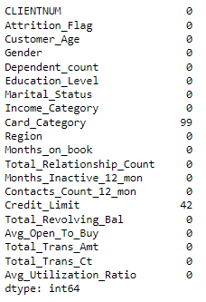
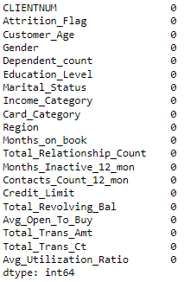
DATA PRE PROCESSING USING PYTHON

Slide 7
01
TASK

Slide 8
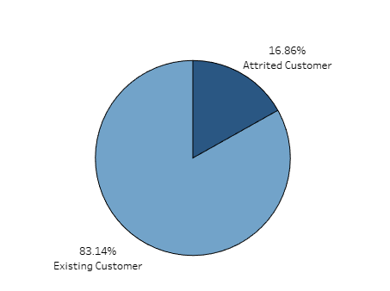
01
TASK
Display the percentage of attrited and existing customers from the data.

Slide 9
02
TASK

Slide 10
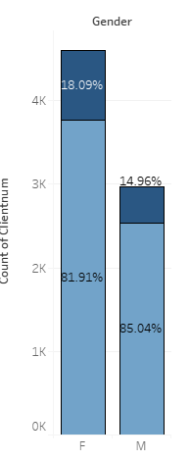
02
TASK
Display gender wise percentage of existing and attrited customers.

Slide 11
03
TASK

Slide 12
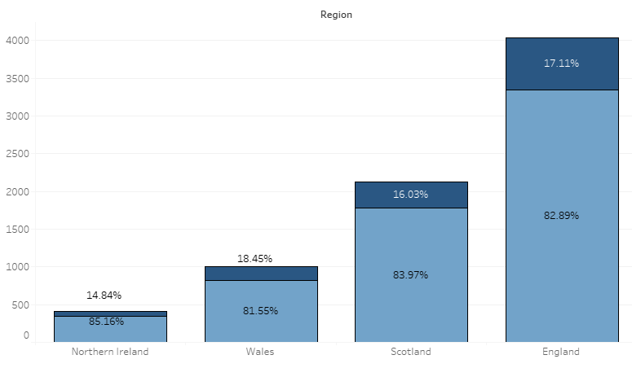
03
TASK
Display region-wise percentage of attrited and existing customers.

Slide 13
04
TASK

Slide 14
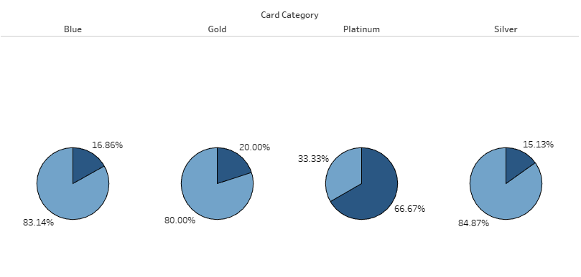
04
TASK
Display the percentage of attrited and existing customers for each card category.

Slide 15
05
TASK

Slide 16
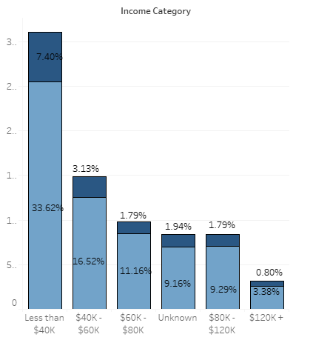
05
TASK
Display the percentage of the attrited and existing customers for each income category.

Slide 17
06
TASK

Slide 18
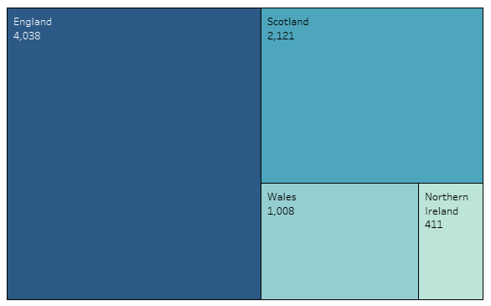
06
TASK
Display region-wise count of customers. Identify the region that has the maximum number of customers.

Slide 19
07
TASK

Slide 20
07
TASK
Create an interactive dashboard by the following given instructions.
Create a figma template for the dashboard.
Design the dashboard with the charts created in tasks 1-6.
Apply action filters on the charts created in tasks 1 and 6.

Slide 21
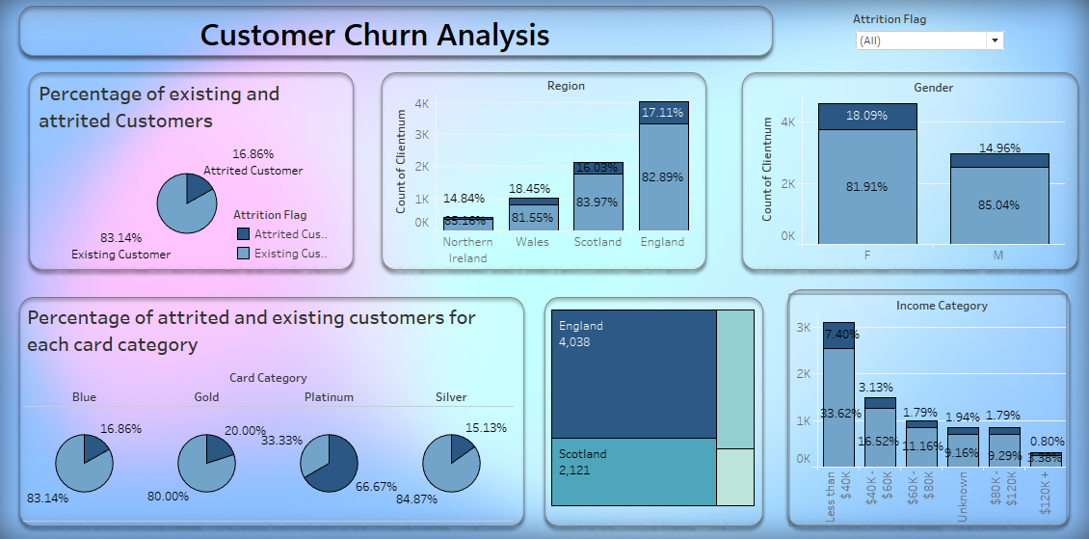
07
TASK

Slide 22
08
TASK

Slide 23
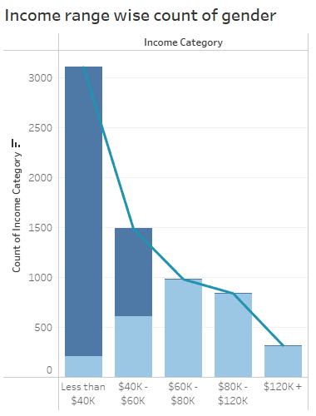
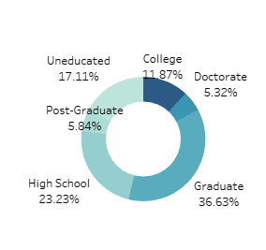
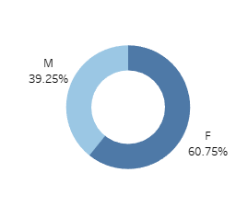
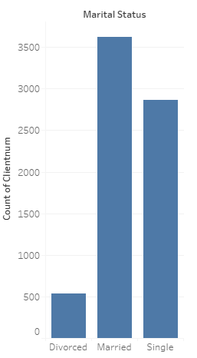
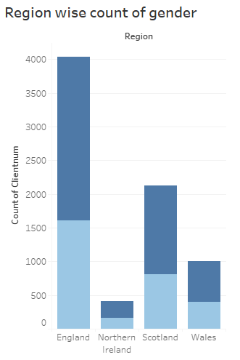
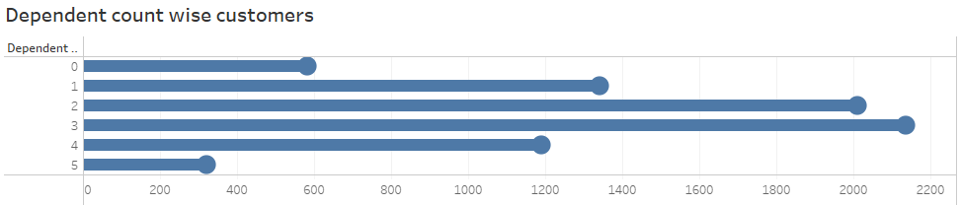
08
TASK
Identify 5 to 10 more points of analysis, present them using charts/graphs, and build an interactive dashboard using these charts and graphs. Give proper interpretations by inferring data from the dashboard.

Slide 24
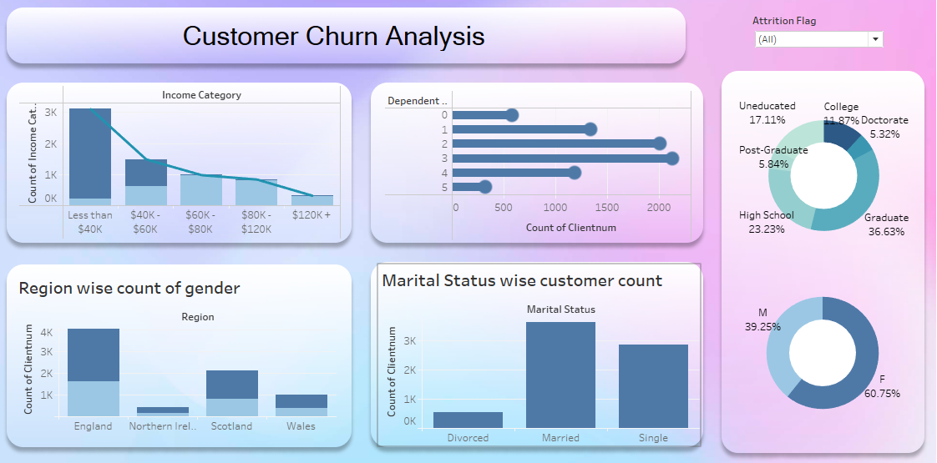
08
TASK

Slide 25
INTERPRETATION:
Interpretations:
Most of our customers are married.
The majority of our customer base comprises females.
Most of our customers hold a graduation degree.
A significant proportion of our customers have three dependents.
The majority of our customers earn less than 40k.
England has the highest concentration of our customers.
We can develop marketing campaigns that specifically appeal to female customers or college graduates , highlight financial products and services that address their unique needs and preferences.
Offer financial products and services that cater to customers with dependents, such as family savings accounts, education savings plans, and insurance packages tailored for families.
Create banking products and services that are suitable for customers with lower incomes
Recognizing that England has the highest concentration of our customer base , we can consider expanding your branch network there.

Slide 26
THANK YOU!

